Slide 1

VIBRATION ANALYSIS OF TALL STRUCTURES
Presented by
ANKIT RANJAN -236103004
KONAPALA SAI SRAVAN-234103421
SUMANTA DAS-234103440
DEPARTEMENT OF MECHANICAL ENGINEERING
INDIAN INSTITUTE OF TECHNOLOGY
GUWAHATI

Slide 2
OUTLINE
1-Introduction
2-Objective
3-Methodology and Investigation
4-Result
5-Conclusion
6-Appendices

Slide 3
INTRODUCTION
VIBRATION- The mechanical oscillations of an object about an equilibrium point.
VIBRATION CONTROL-It consists of the introduction of such vibrations of the dynamic system parameters which modify the properties of the system in a desired manner
Tall structure -It is that type of concrete structure in which height of structure is so large in comparison to area.

Slide 4
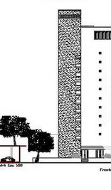
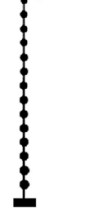
continued
-We are doing the modal analysis of tall structure
-The important parameters for analysis is
1-Mass of building
2-stiffness
3-Height
Modal analysis result gives
1-Resonant frequency
2-Mode shapes
-

Slide 5
OBJECTIVE
To analyze and investigate the vibration of tall structure

Slide 6

METHODOLOGY AND INVESTIGATION
We are using normal mode analysis for getting vibration of tall structure
Height of structure = 100m
No of floors in structure =10m
Mass/floor = 900ton
Stiffness =10Gpa
Governing equation: =

Slide 7
Steps to calculate ω and Mode Shapes-
Step1- The Governing equation is MX’’+KX=0, and we taken the solution as X=Ae^(i ωt)
Step2- Calculating (- ω^2*M+K)X=0
Step3- | - ω^2*M+K |=0 , solving this equation we get 10 frequencies
Step4- For different frequency value ,we get different mode shape vector by solving the mentioned equation .
Step5- After assembling the mode shape vector we get P as Modal matrix.

Slide 8
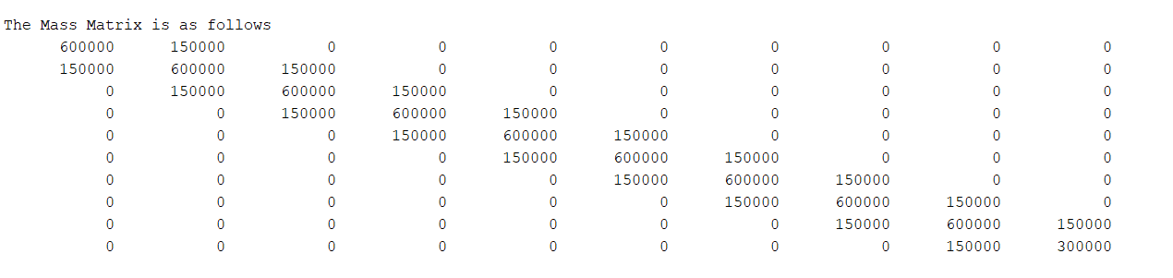
Analysis has been done using FEM by assuming lumped mass system
Mass matrix of tall structure

Slide 9
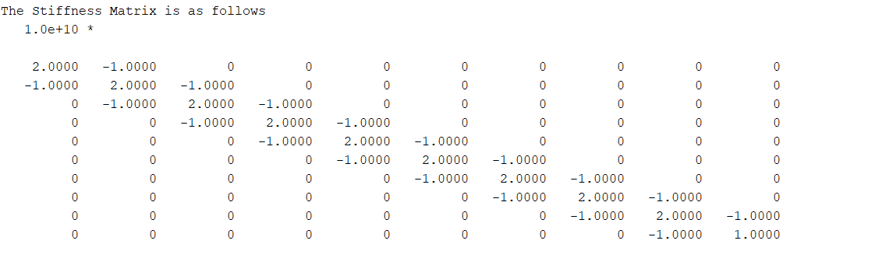
continued
Stiffness matrix for tall structure

Slide 10
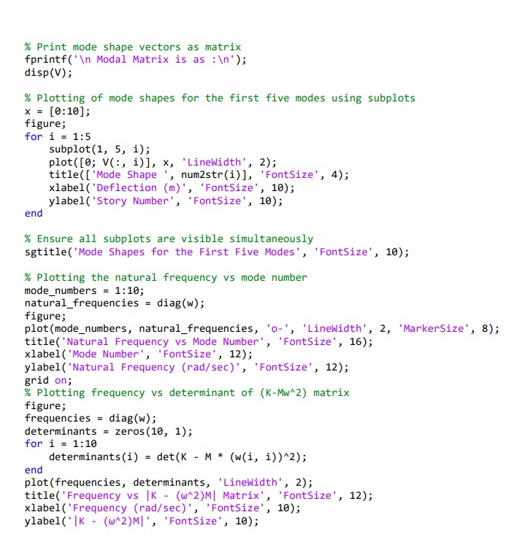
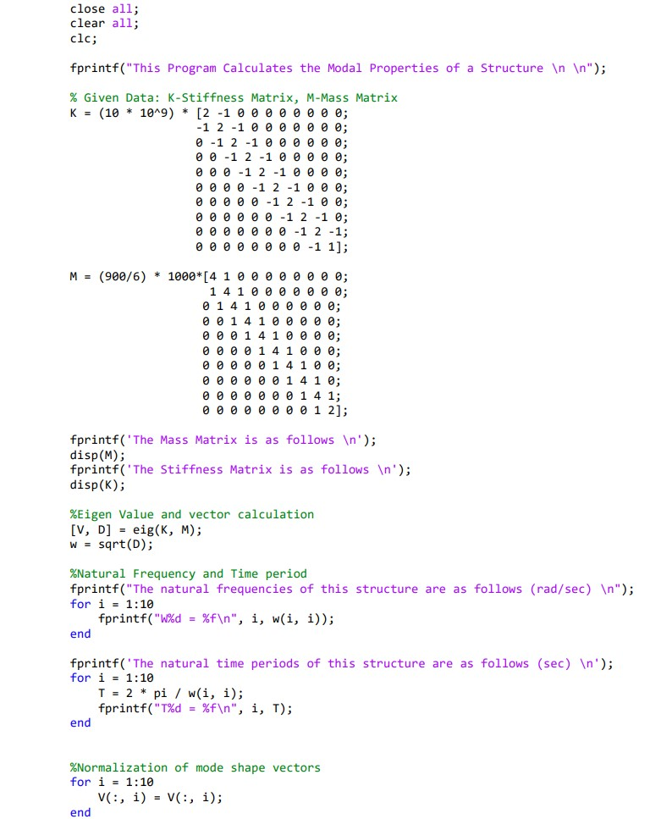
MATLAB CODE

Slide 11
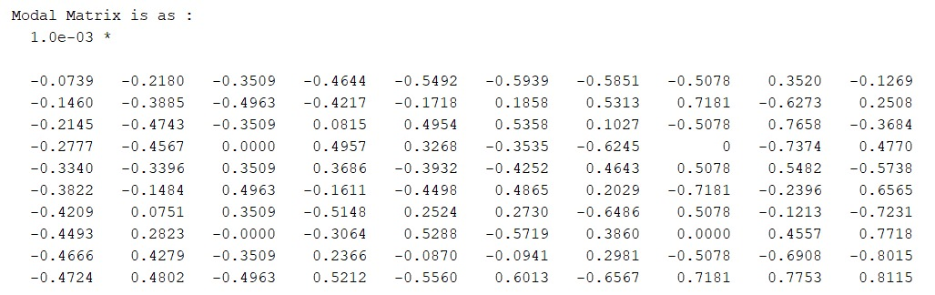
Result
Mmmmmmmmmmmm
Fig- Modal matrix of system

Slide 12
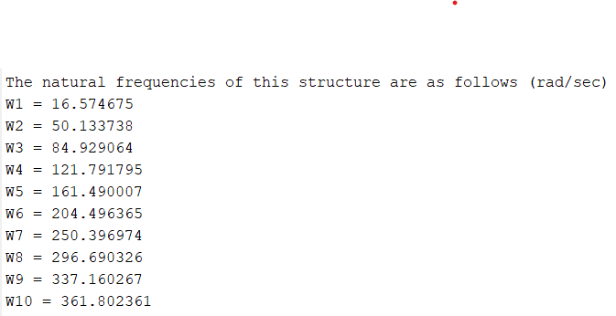
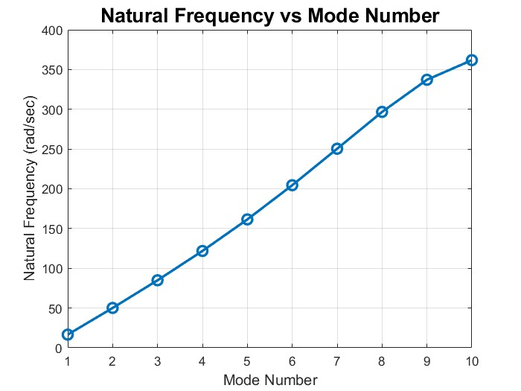

Slide 13
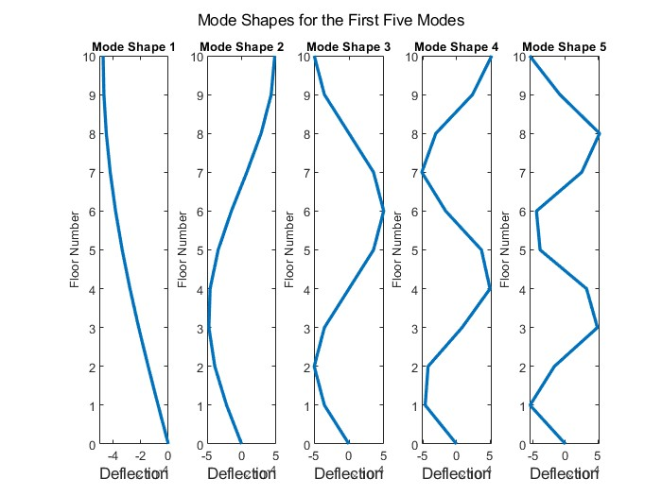

Slide 14
CONCLUSION
Thus, we are getting the natural frequency of the system
IF the structure excitation frequency reaches resonance it become critical .
Before that we need to take care that our design meets the occupant comfort requirement.
For this we need to go for vibration reduction method that control the vibration of the structure.
Some of the important methods are
1-Tuned mass damper(TMD)
2-Tuned liquid column damper(TLCD)

Slide 15
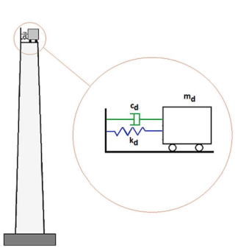
Tuned mass damper (TMD)-It also known as a harmonic absorber or seismic damper, is a device mounted in structures to reduce mechanical vibration.
Its mechanical simplicity and reliable operation
made TMD the powerful passive vibration
control device.

Slide 16
REFERENCE
1-Parametric study of wind induced vibration control of tall building using TMD and TLCD system by Nahmat Khodai (2024).
2-Modal analysis of structural vibration by M.L. Chandravanshi and A.K. Mukhopadhyay.
3-Wind induced motion of tall building by Ferrareto a johann,Mazzilli e n carlos, Franca l s ricardo

